Slide 1

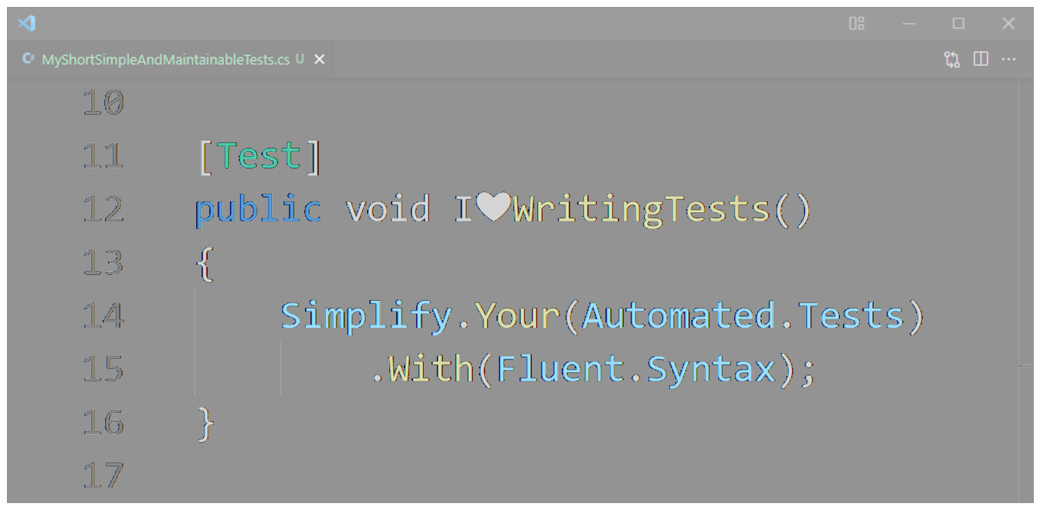
Simplify .Your(Automated.Tests) .With(Fluent.Syntax)
«Zusammen MehrWert»
Filialmeeting 23.11.2021

Slide 2
Content
Example
What
Why
How
Do’s & Don’ts
More .NET Code Samples
github.com/appgemacht/SimplifyYourUnitTestsWithFluentSyntax
Notes:
Example
What
Why
How
How not
If enough time: more .NET Code Samples
You can clone the sample repo (Share link in chat)
github.com/appgemacht/SimplifyYourUnitTestsWithFluentSyntax

Slide 3

Example
Notes:
Next Slide

Slide 4
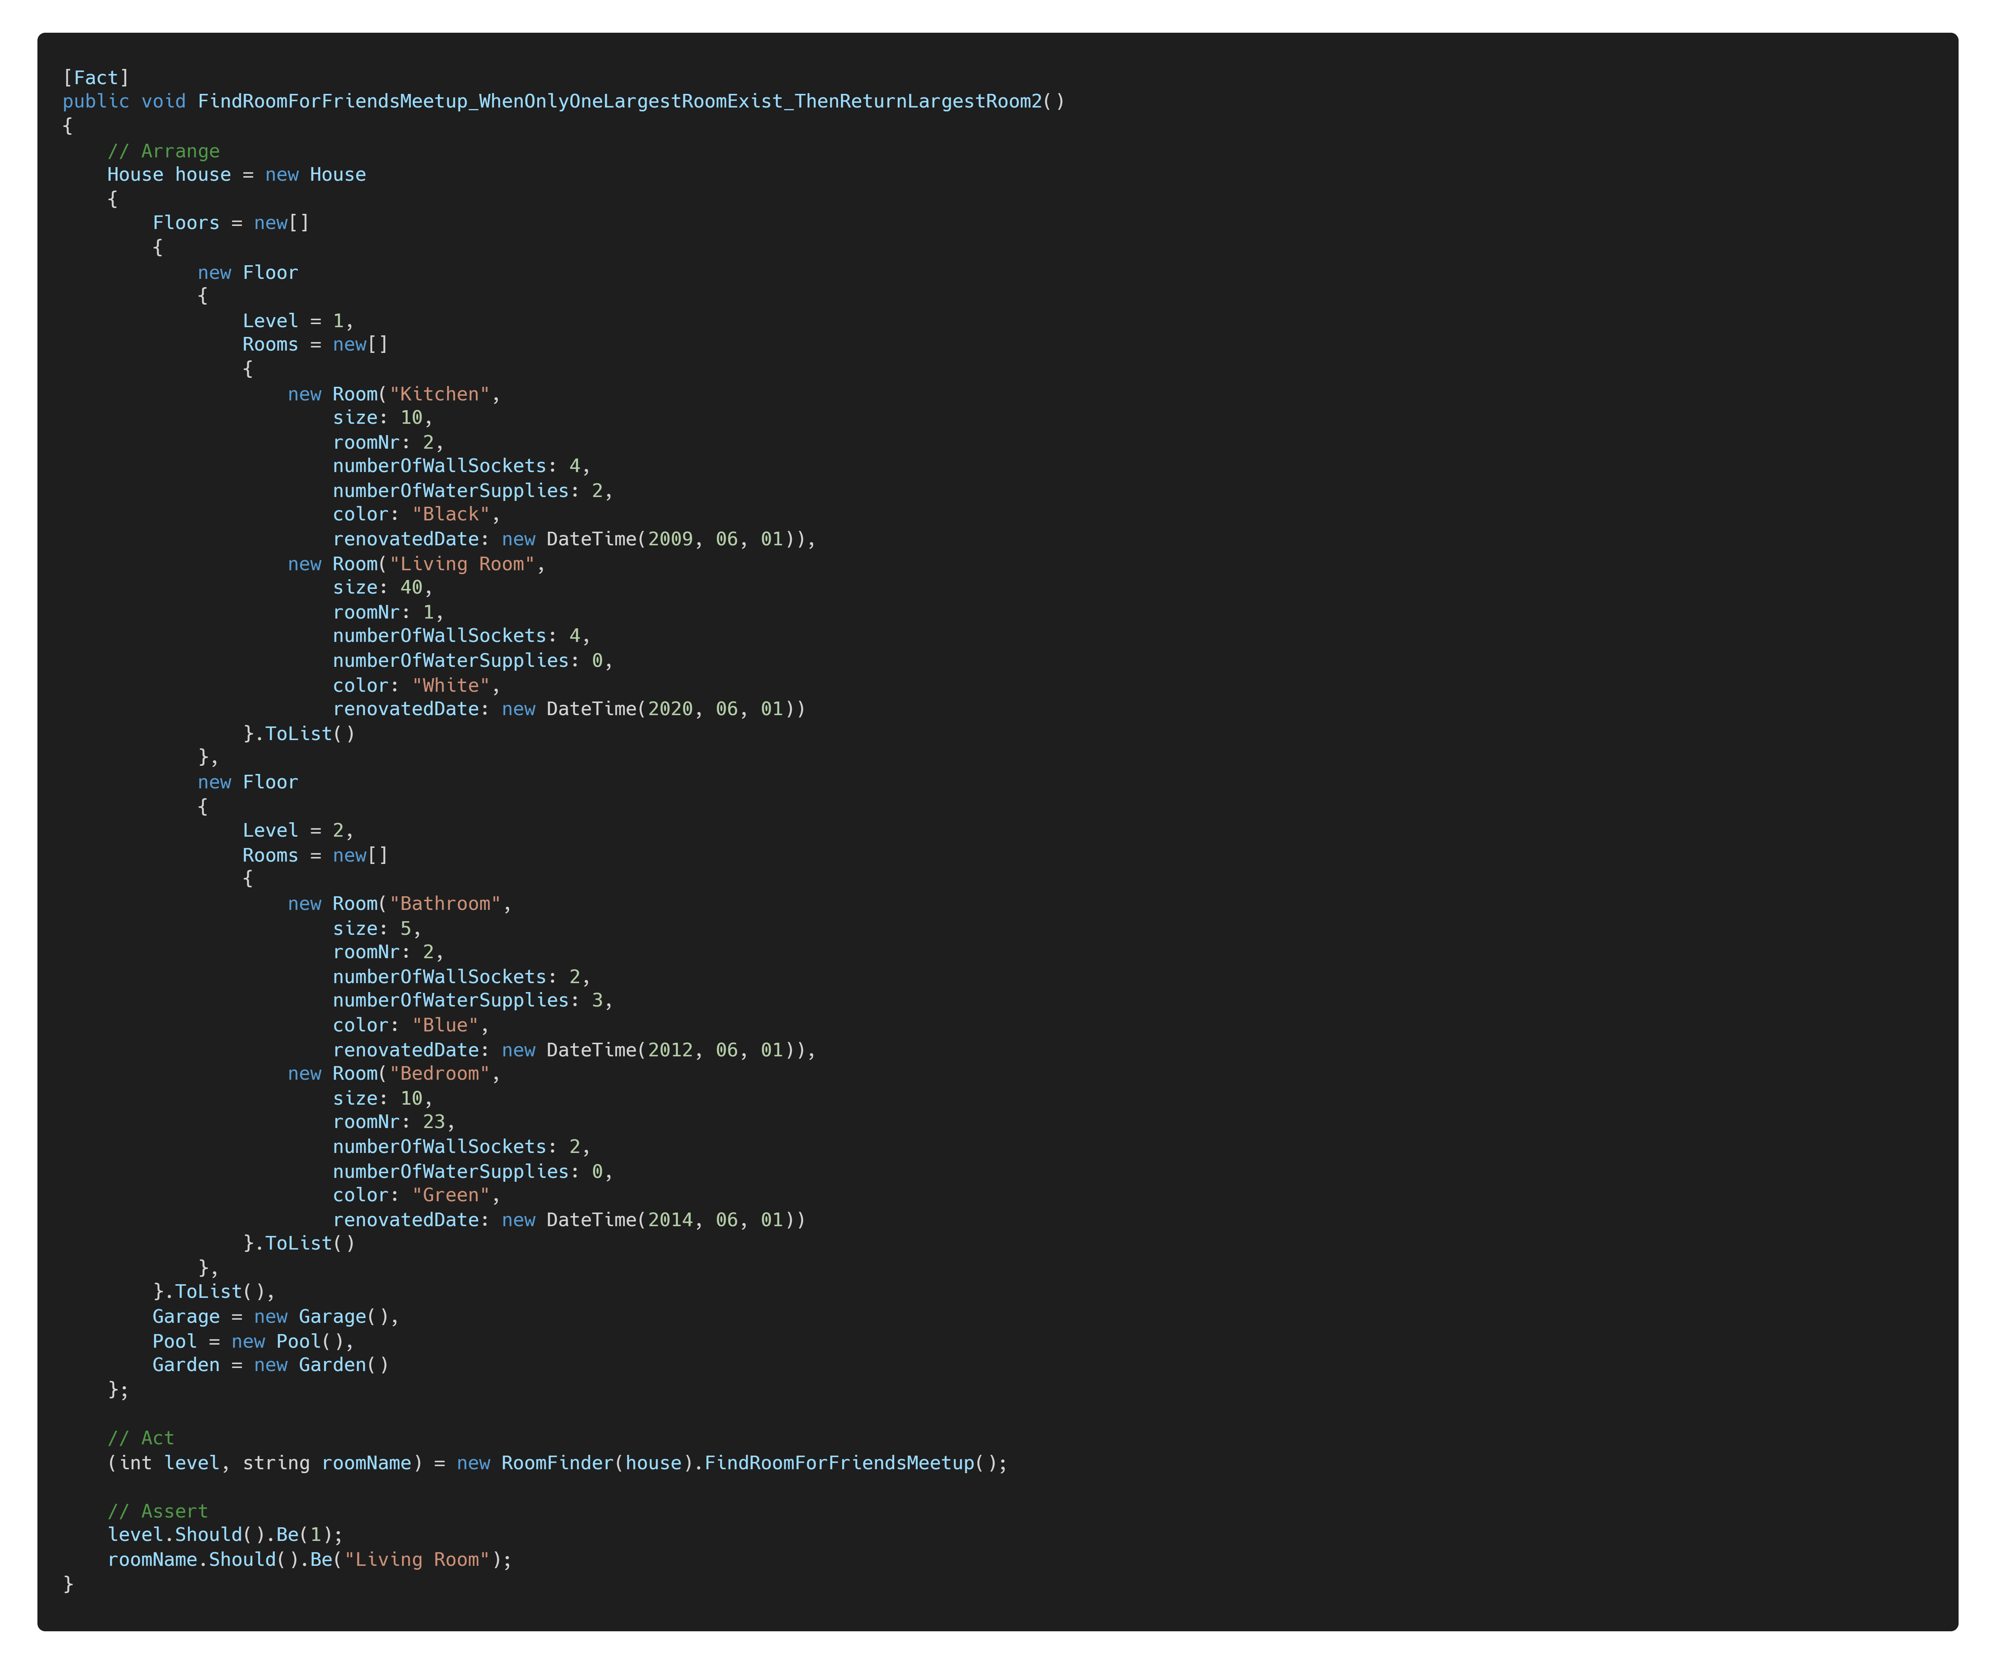

Without Fluent Syntax
Notes:
Switch to IDE.
Show RoomFinderTest Classic (large)
Show House.cs
Show RoomFinder
Show RoomFinderTest Classic (large)
Show RoomFinderTest Extensions (small)
Show RoomFinderTest Builder (small)
https://carbon.now.sh/nPIJ2FX2mlz5QKcSxInP

Slide 5
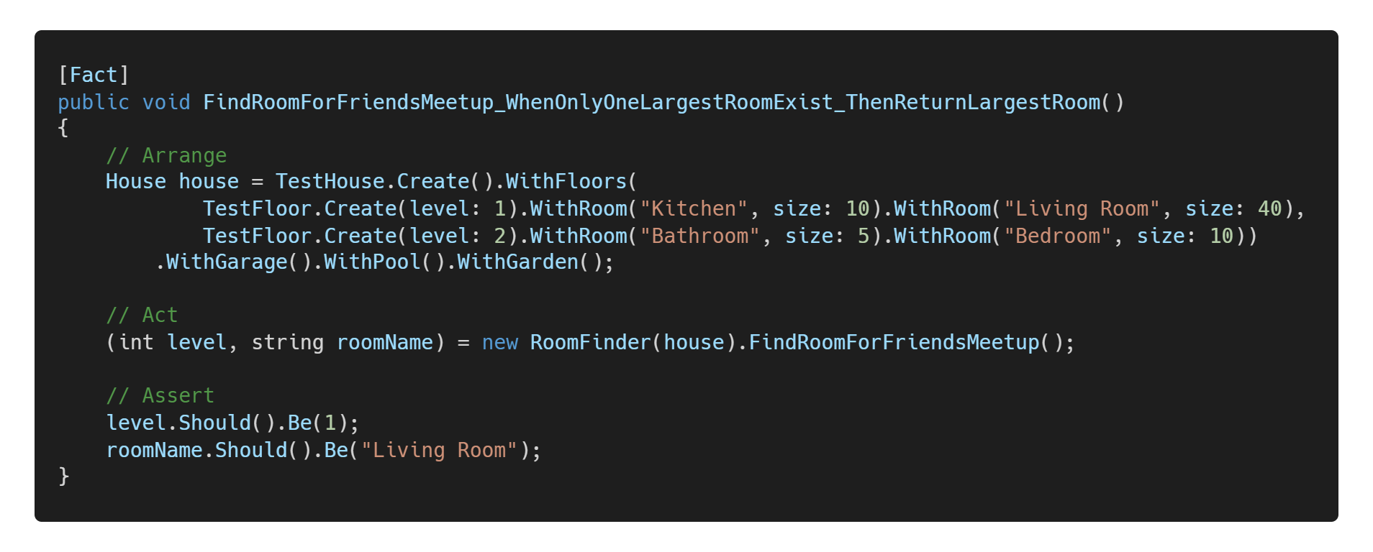
With Fluent Syntax
Notes:
https://carbon.now.sh/HOkxueZRJprR76cYCTzf

Slide 6
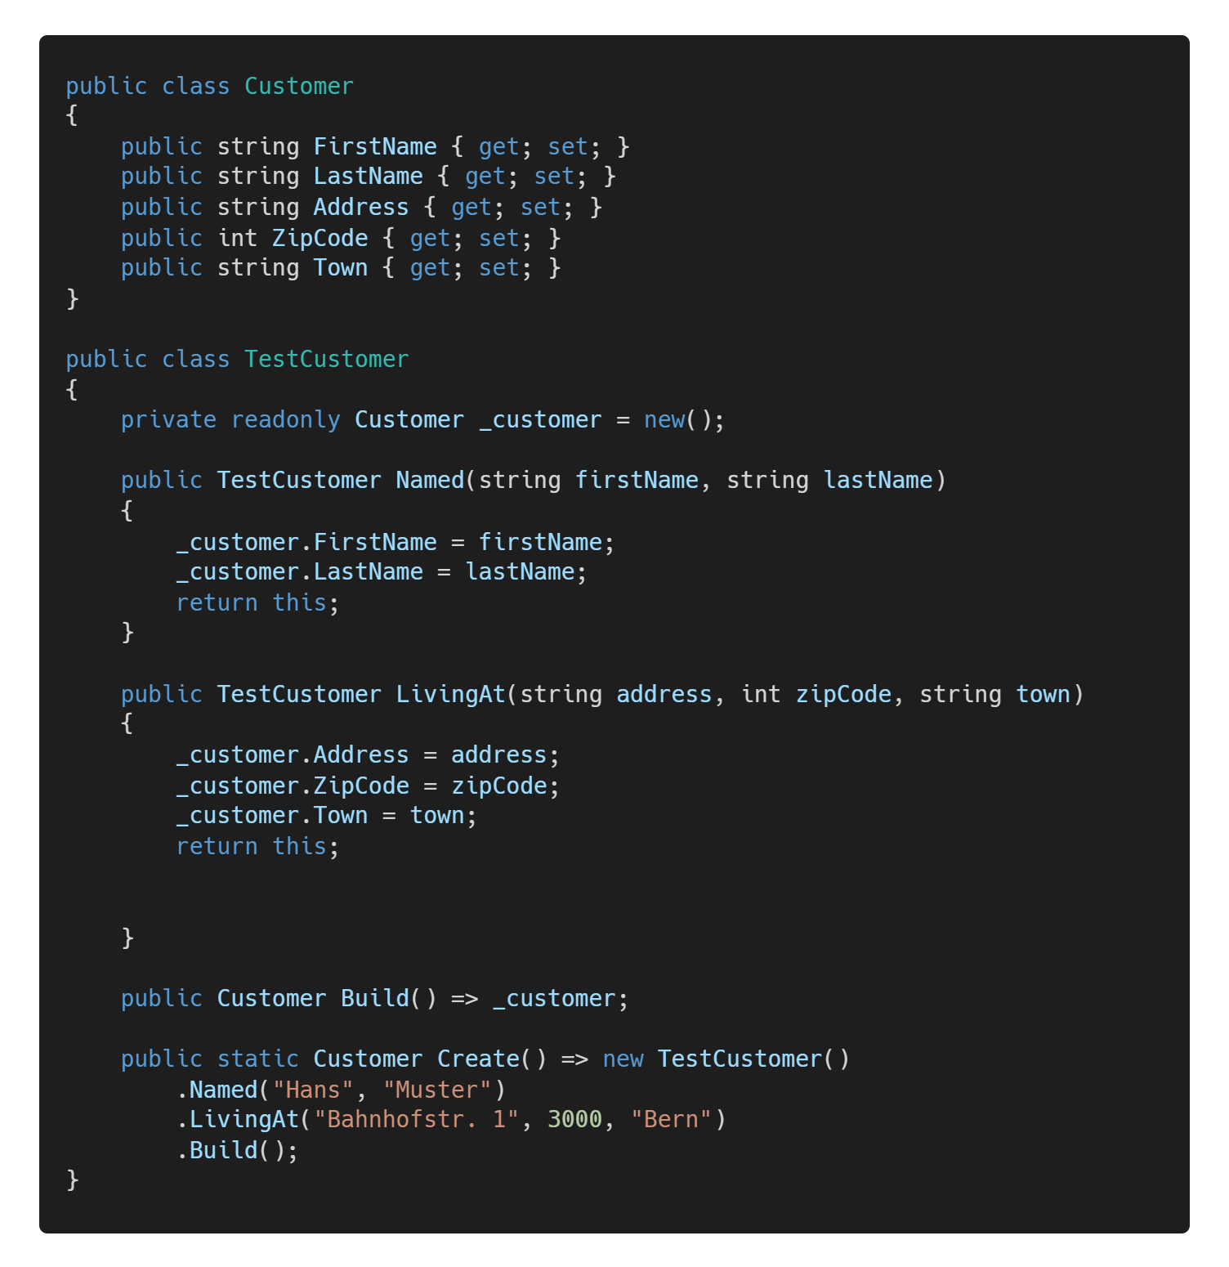
What do I mean with "Fluent Syntax"?
Fluent interface, Fluent API
An API using method chaining and the builder pattern (returning ‘this’)
Goals:
write in natural human language
make the code more domain-specific (DSL)
decouple creation from the object/data itself
Popular libraries:
C# LINQ/FluentAssertions
Java Stream API/AssertJ
Javascript jQuery/Jasmine...
Notes:
Test API
I'm also mentioning some other best practices for tests without Fluent Syntax.
Fluent interface, Fluent API
Show Customer
An API using method chaining
Show Create()
Implemented with the builder pattern (returning ‘this’)
Show Named(…), LivingAt(…)
Goals:
write in natural human language
make the code more domain-specific (DSL)
decouple creation from the object/data itself
Popular libraries:
C# LINQ (Query language, SQL-like/FluentAssertions (see TestCase Assert Steps)
Java Stream API/AssertJ (analog C#)
Javascript jQuery/Jasmine (UI testing)...
https://carbon.now.sh/zDtsRMfvpfwTueRan8vu

Slide 7
“Remove everything that has no relevance to the story. If you say in the first chapter that there is a rifle hanging on the wall, in the second or third chapter it absolutely must go off. If it’s not going to be fired, it shouldn’t be hanging there.” Anton Chekhov, Russian Writer
Notes:
Before we see the Advantages of Fluent Syntax, I show you a quote of a famous russian writer, Anton Chekhov

Slide 8
Chekhov's Gun
Everything within the body of a test should be important and influence the code path being tested
Everything else will make the tests noisy and hard to understand.
BUT: Do not hide any important values (e.g. level: GetLevel())
Notes:
What it means for automated software tests:
Everything (all visible values or method calls) within the body of a test should be important and influence the code path being tested. Do you know which values are important and why?
room name
size
level
2x Click
Everything else will make the tests noisy and hard to understand. Which values are unimportant?
roomNr
renovatedDate
color
NumberOfWallSockets
NumberOfWaterSupplies
BUT: Do not hide any important values in helper method/field initializer/ctor/class
e.g. level: GetLevel()

Slide 9

Advantages of a Test API / Fluent Syntax
Using productive code is different in tests
Prevents changes from productive code refactoring
Readability(test code) = Readability(productive code)
Our team convention: max 1 screen height/test
Notes:
Using productive code is different in tests:
because you need to mock/fake some dependencies.
Is anyone of you annoyed by test code that breaks when you refactor the productive code? Abstraction Layer prevents changes from productive code refactoring
Readability(test code)= Readability(productive code)
Our convention: max 1 screen height/test

Slide 10
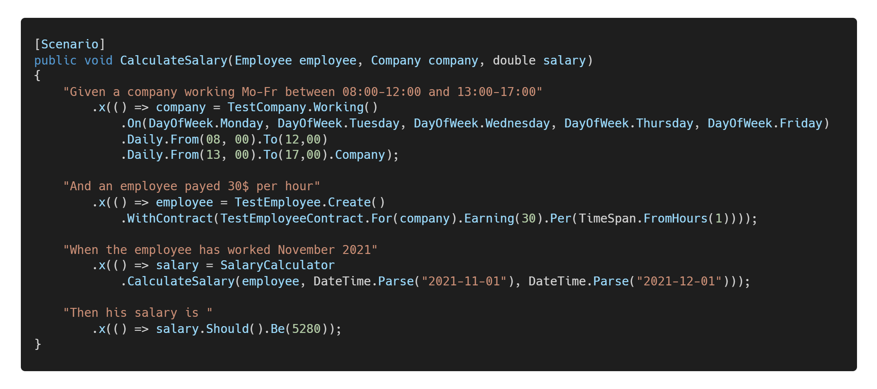
Acceptance Tests with Fluent Syntax
Notes:
Now we come to the topic how Fluent Syntax supports
Acceptance Tests
Behaviour Driven Development
Acceptance test–driven development (ATDD).
There aren’t only unit tests.
We have tests with different granularity/level (Algorithm, Group of classes, Component, UI…)
This example (Salary Calculator) is a higher-level integration test with the xBehave framework
Explain
Input: Employee, Company
Output: Salary
BDD/ATDD uses Given/When/Then Steps
Explain the test steps
You see:
the tests is written in domain-specific human language
specifies the expected software behaviour
looks like "coded" acceptance criteria
Living documentation of your system (Specification by example)
Makes it easier to discuss with your team members (or even Stakeholders?)
Fluent Tests support the approach of BDD/ATDD because:
The implementation of Given/When/Then steps could be written in place with the step definition
The implementation can be reused.
https://carbon.now.sh/oz94KmohxEMqbSwyBZVD

Slide 11
Fluent Tests and ATDD
Domain-specific human language
Specifies the expected software behaviour
Looks like "coded" acceptance criteria
Fluent Tests support the approach of
Behaviour Driven Development
Acceptance test–driven development (ATDD).
The implementation of Given/When/Then steps could be written in place with the step definition
Makes it easier to discuss with your team members (or even Stakeholders?)
Living documentation of your system (Specification by example)

Slide 12

How to write better tests
Notes:
Before I show you how to write better tests,
lets see how the Acceptance Test will look like without Fluent Syntax
Switch to DIE
Show FluentCompany.AcceptanceTests.Fluent.SalaryCalculationFeature
Show FluentCompany.AcceptanceTests.Classic.SalaryCalculationFeature
Show unit test window
Show Github Repo/Page/Code Samples
Show https://github.com/appgemacht/SimplifyYourUnitTestsWithFluentSyntax#how-to-write-better-tests
Show FluentFoo.Foo
Show FluentFoo.Tests.FactoryMethods.FooTest
Show FluentFoo.Tests.Extensions.FooTest
Show FluentFoo.Tests.Builders.FooTest

Slide 13

In “Massen” geniessen
Notes:
Like always: Immer im “Mass” geniessen
Use it as much as necessary, as little as possible!

Slide 14
Do’s and Don’ts
Good fluent APIs take a while to build.
Too complex test helpers can lead to bugs in test code
Try to improve your productive code, so you don’t even need test helpers
If your productive classes are bags with getters and setters, named “DTOs”
See AnemicDomainModel.
Prefer object-oriented over procedural style
For legacy code:
Create Tests and Test Helpers around it
Refactor productive code step by step, so you can remove the Test Helpers
Notes:
Good fluent APIs take a while to build.
Too complex test helpers can lead to bugs in test code
Try to improve your productive code, so you don’t even need test helpers
use builders/helpers/static factory methods in production code
use appropriate constructors or factory methods.
separation of concerns, split productive class by features
RoomFinder: separate sizing from coloring.
validate parameter values and ensure the object is always consistent.
make properties immutable if possible.
One goal of Test First/TDD (red-green-refactor cycle)
improve the design of your classes.
instead of the design of your Fluent API
If your productive classes are mutable bags with getters and setters, named “DTOs”
See AnemicDomainModel (Martin Fowler).
Put more behaviour into your domain objects.
Prefer object-oriented over procedural style
For legacy code:
Create Tests and Test Helpers around it
Refactor productive code step by step, so you can remove the Test Helpers

Slide 15
More Code Samples
Notes:
Show final slide and switch to IDE

Slide 16
Thank you
Jean-Marc Vogel
Software Engineer .NET
github.com/appgemacht Noser Blog Post coming soon…
Notes:
Noser Blog Post coming soon
Switch to IDE

